Slide 1
Malicious Software
Viruses and Related Threats
Virus Counter Measures

Slide 2
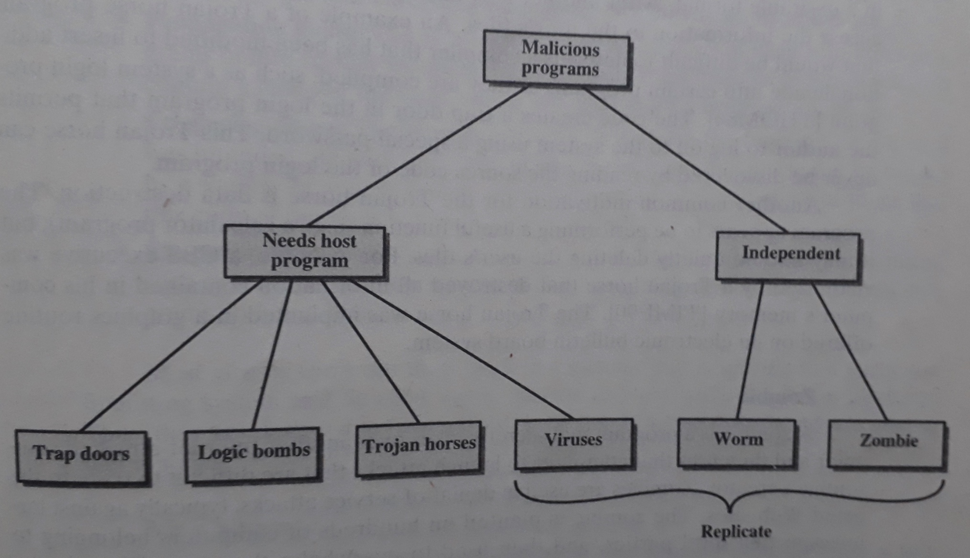
Taxonomy of Malicious Programs

Slide 3
Phases of Virus
During its lifetime, a typical virus goes through the following four phases:
Dormant Phase
Propagation Phase
Triggering Phase
Execution Phase

Slide 4
Types of Viruses
Parasitic Virus
Memory-resident Virus
Boot Sector Virus
Stealth Virus
Polymorphic Virus

Slide 5
Antivirus Approaches
Detection
Identification
Removal

Slide 6
Thank You

